Slide 1
Aurora-CCPM
Critical Chain Project Management with Intelligent Scheduling

Slide 2
About Stottler Henke
Applies artificial intelligence and other advanced software technologies to solve problems that defy solution using traditional approaches.
Planning & Scheduling, e.g., Aurora-CCPM
Education & Training
Decision Support
Knowledge Management & Discovery
Founded in 1988
www.StottlerHenke.com

Slide 3
Aurora-CCPM History
1990 1st Intelligent Scheduling Project – NASA’s Kennedy Space Center (KSC)
1990’s Several IS projects independent of each other (most at NASA)
1999 Aurora conceived to subsume all
2000 Aurora designed and prototyped
2001 – 2003 Main Aurora implementation
2002 1st Aurora application delivered
2005 Critical Chain enhancement: Boeing & others
Driven by need for Critical Chain capabilities that no one else had

Slide 4
Aurora-CCPM Critical Chain Summary
Enterprise Level Critical Chain Project Management Software
Multi Project
Completely stand-alone
Does NOT depend on any other product
However, designed to interface with other project management software and exchange information with databases

Slide 5
Aurora Unique Capabilities
Enterprise level Critical Chain
Multiple-pass intelligent resource-constrained scheduling
Mixed-mode scheduling providing both forward and backward scheduling, available on a task-by-task basis.
Schedule Rationale – Aurora includes the rationale for each task on why it was schedule where it was schedule.
Designed to interface with other tools

Slide 6
Flexible Deployment
Completely stand-alone application on Windows, Linux & Mac
Standalone Aurora with Database access
Aurora Server version with Web access
Flexible deployments
Windows XP to Windows Server
Linux
Mac
32 or 64-bit

Slide 7
Potential Workflow w/ Current Project Mgmt. Software: E.g., Primavera P6
Build in Primavera P6
Transfer to Aurora
Schedule in Aurora
Transfer results to Primavera P6
Transfer status information back to Aurora
PMs use updated Primavera P6 model for execution
Enter status updates into Primavera P6

Slide 8
Aurora 3rd Party Interface For example: Primavera P6 & DB / SAP
Primavera P6
XML
Aurora
Primavera P6
XML
Aurora
DB / SAP
Aurora
DB / SAP
Primavera P6

Slide 9
Aurora-CCPM Screenshots: Overview

Slide 10
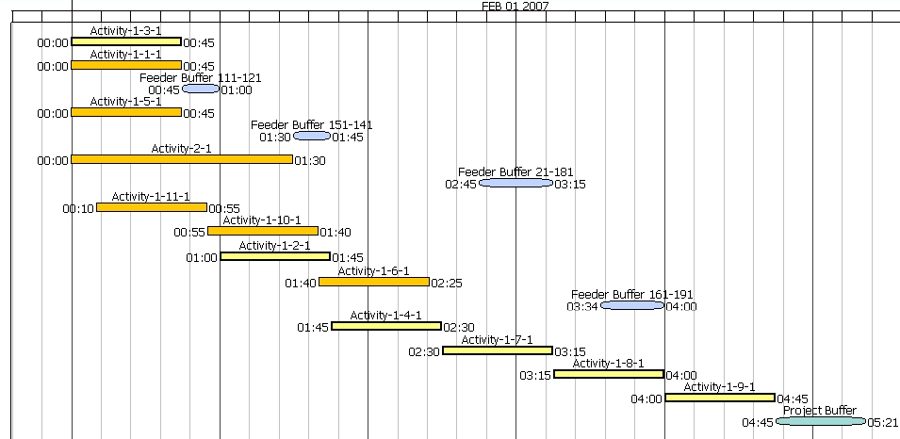
A Small Critical Chain Project (Critical Chain in Yellow w/ Bold Outline)

Slide 11
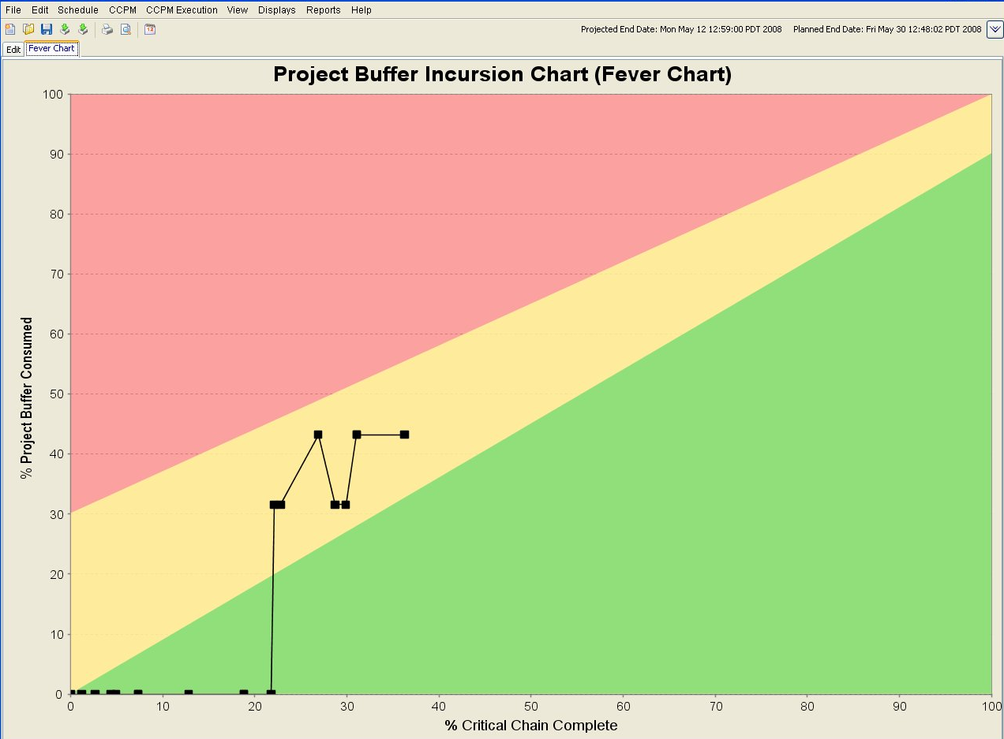
Fever Chart

Slide 12
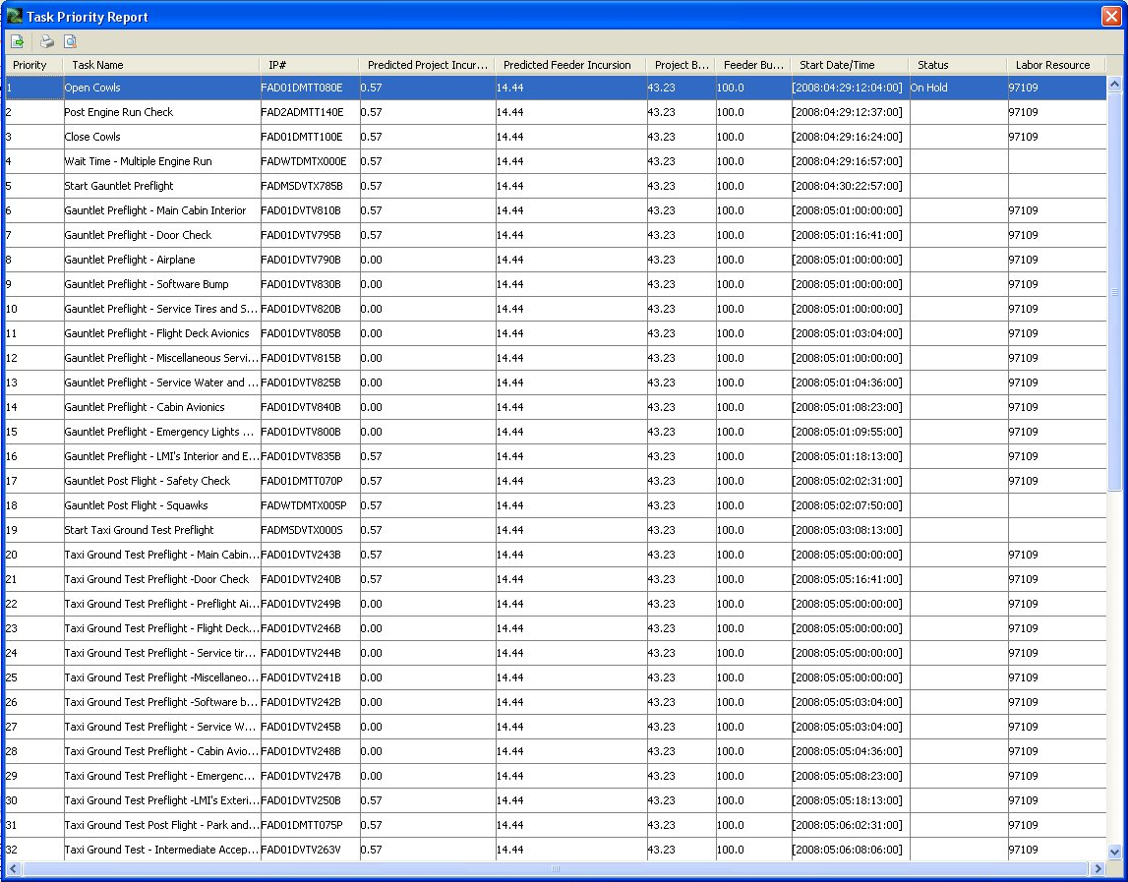
Task Priority Report

Slide 13
Aurora / Aurora-CCPM Applications
Boeing 787 Aircraft Assembly (replaced 20 year, in-house Timepiece product)
Space Shuttle Processing
Space Station Processing Facility (SSPF) floor space and resources
Navy Ship System Upgrades
Crew Exploration Vehicle (CEV) In-space crew/resource
Ballistic missile intercepts
Electronic Intelligence (ELINT) aircraft/sensors
In every domain attempted, Aurora has surpassed all existing scheduling systems

Slide 14

Boeing Airplane Assembly Scheduling
Very large, complex models
Large numbers of resource contentions, constraints
Widely distributed users working on different projects
Part of integrated management system
Accepts inputs from corporate modeling system, sends outputs to shop floor management system

Slide 15

Learjet Multi-Phase Assembly Scheduling
Many small, inter-related models
Each model must be managed separately, but may impact other models
Significant resource contention, moderate additional constraints
In long term, models to be used both for long-term projections and short-term recovery management

Slide 16
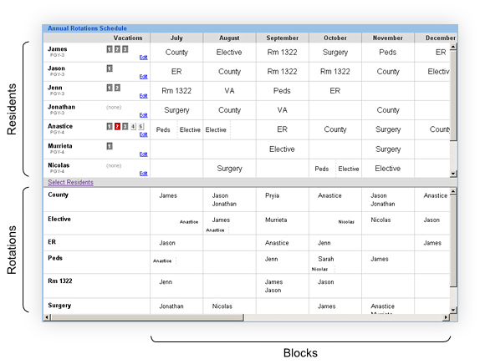
Medical Resident Scheduling
Involves allocating residents for hospital staffing and educational purposes
150+ residents must be scheduled for a full year
Extensive rules provide flexible constraints for an acceptable schedule

Slide 17
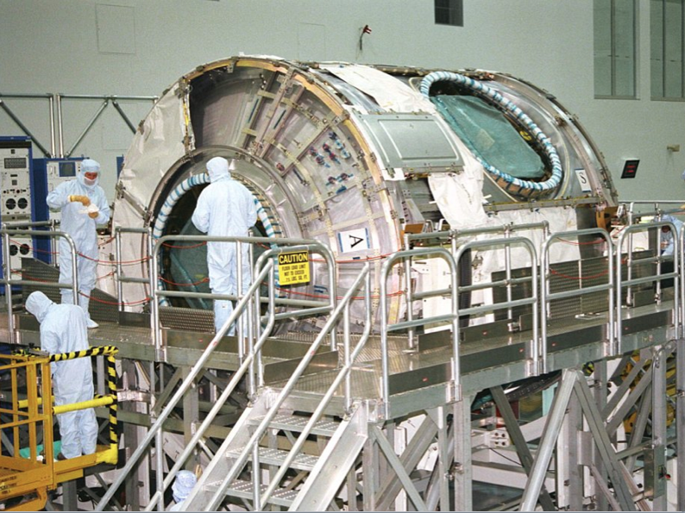
Space Station Processing Facility Scheduling
At NASA’s Kennedy Space Center, Aurora schedules the use of floor space and other resources at the Space Station Processing Facility, the world’s largest low-particle clean room where International Space Station components are prepared for flight.

Slide 18
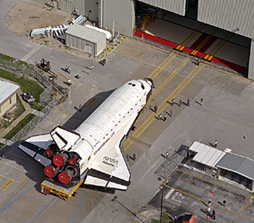
The Value of Aurora: NASA
“Aurora is used daily to support major processing and space shuttle launch decisions; to coordinate our launches with those of Russia, Japan, and the European Space Agency; and to determine NASA's launch requirements and flight rates," says NASA Shuttle Processing Manager Tom Overton. "It enables us to generate complex schedules in a few hours, compared to days or weeks required by our previous scheduling systems."

Slide 19
Acquisition Decision Expert Planning Tool (ADEPT)
Aurora is included in ADEPT, an intelligent acquisition and planning tool for upgrading U.S. Navy systems.

Slide 20
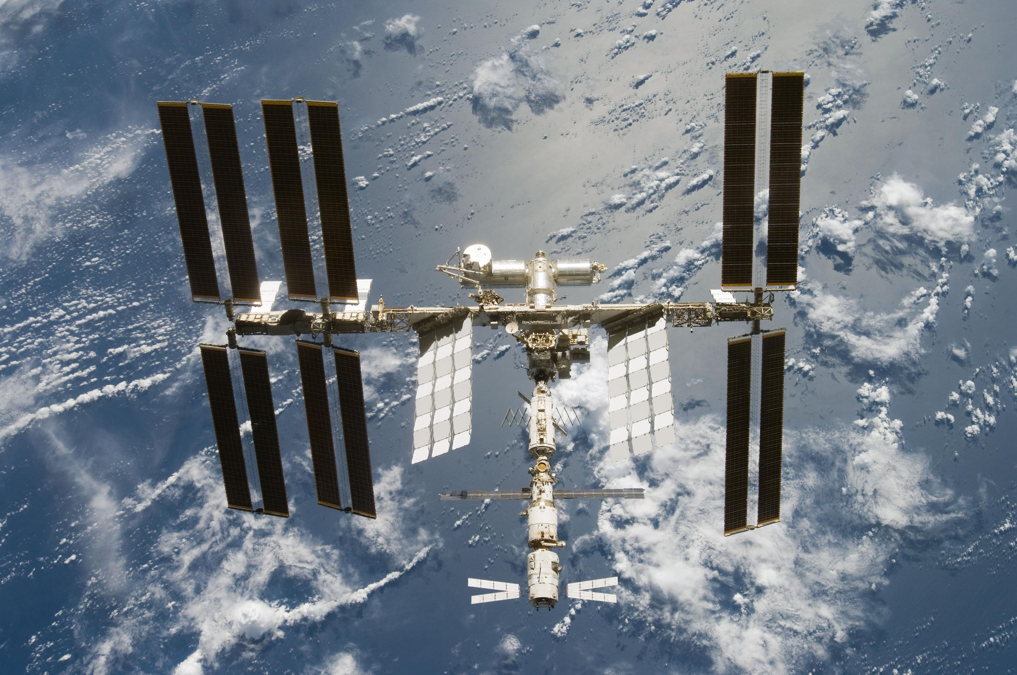
Temporis
Aurora is included in Temporis, a scheduling system by the United Space Alliance, to be used by NASA crew members on-board next generation of space vehicles, and is currently being tested on the International Space Station (ISS)

Slide 21
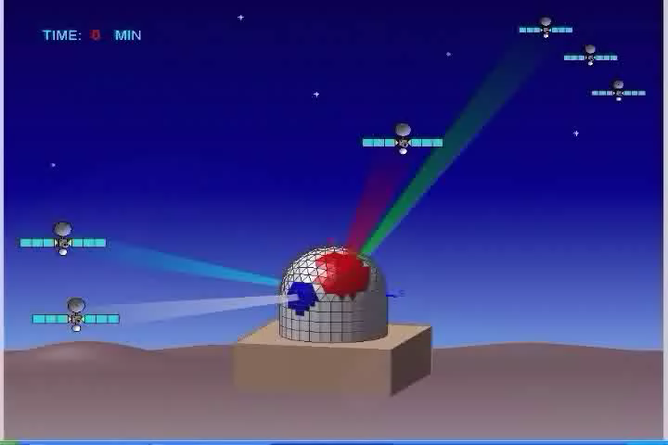
Phased Array Smart Allocation and Planning (PASAP)
Solution to optimize beam allocation and path planning solutions for satellite communication events with Geodesic Dome Phased Array Antennae (GDPAA)

Slide 22
Aurora-CCPM Screenshots & Videos

Slide 23
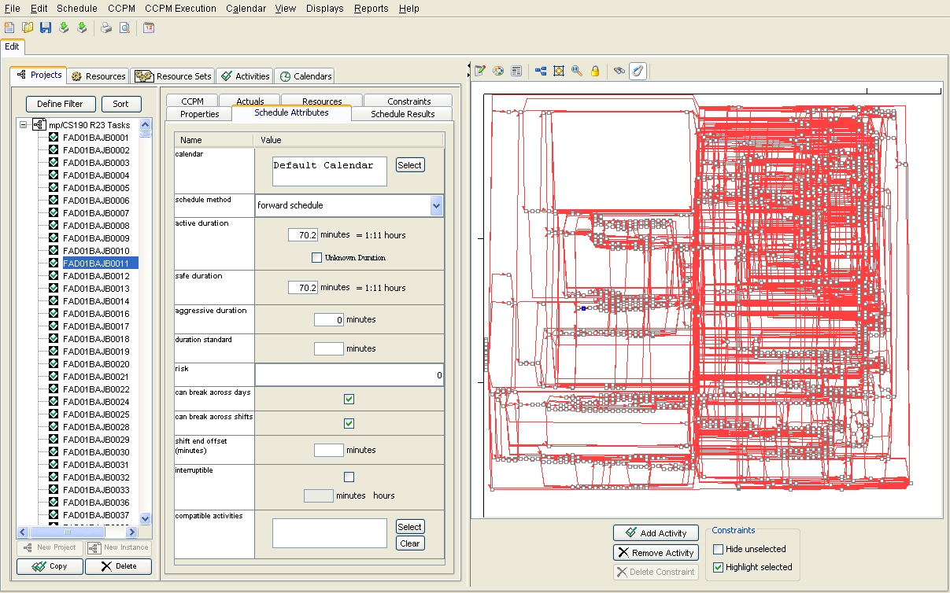
Aurora: Main Project View

Slide 24
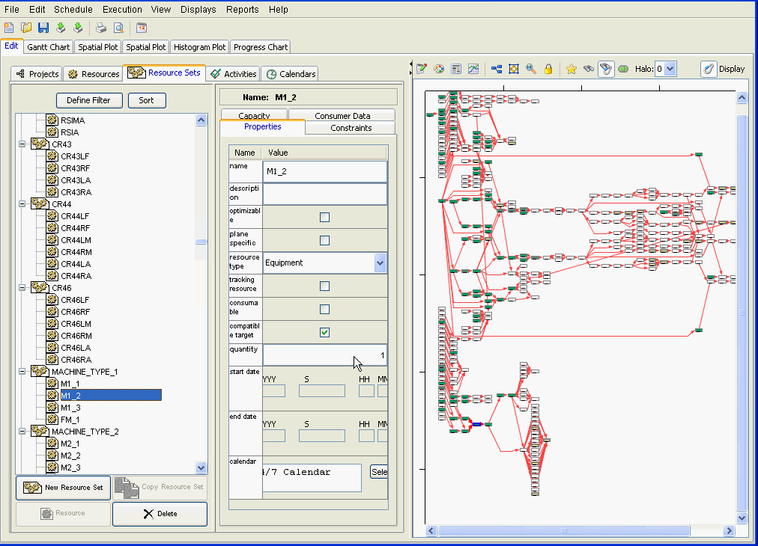
Resource Sets

Slide 25
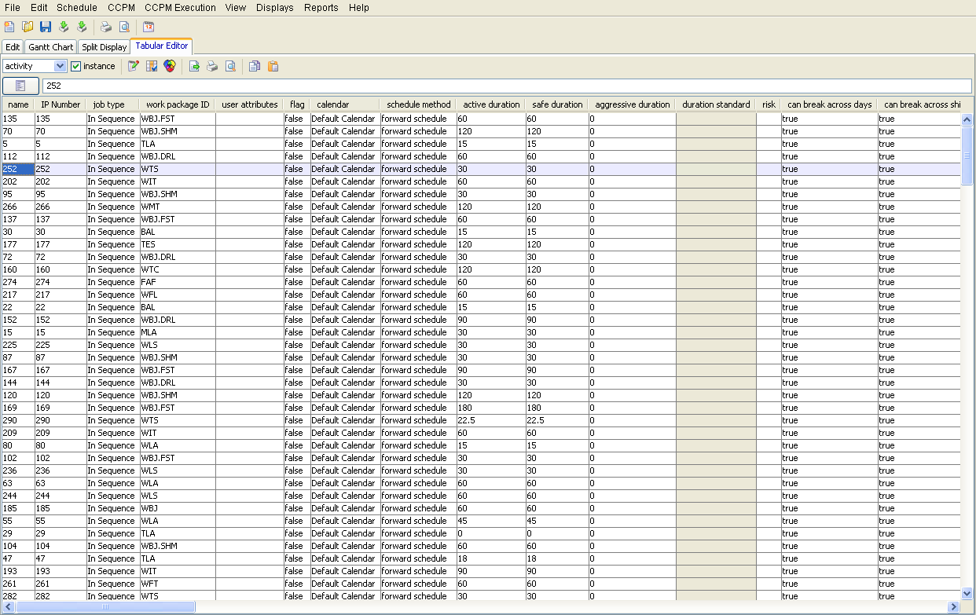
Tabular Editor

Slide 26
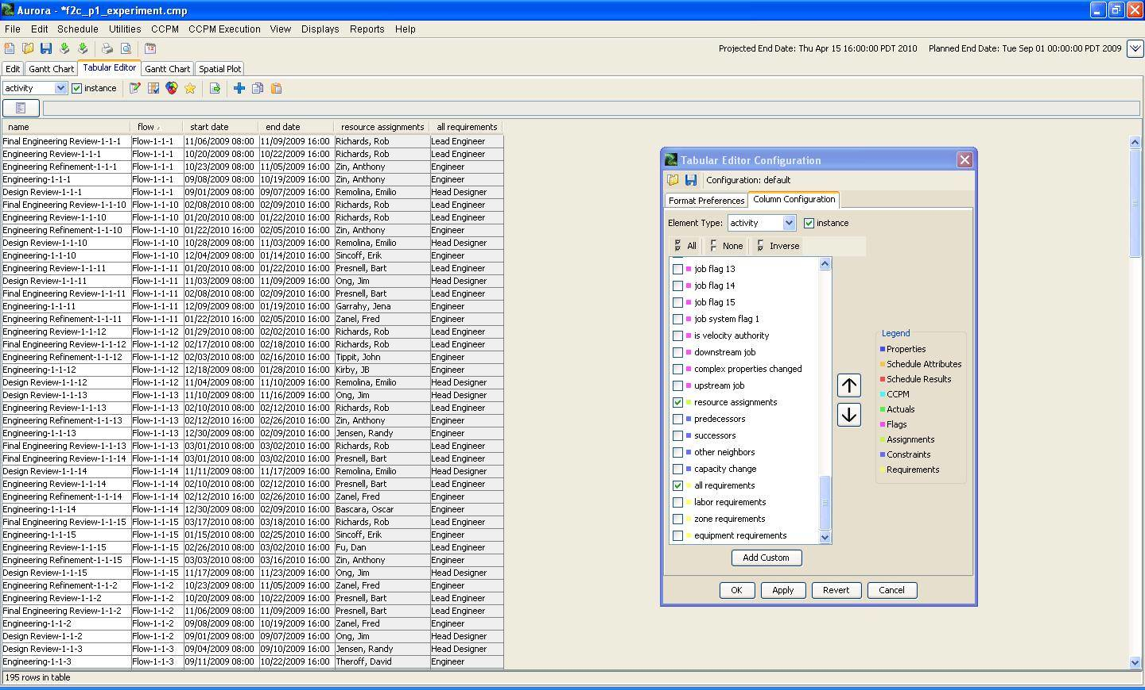
Tabular Editor: Configuration

Slide 27
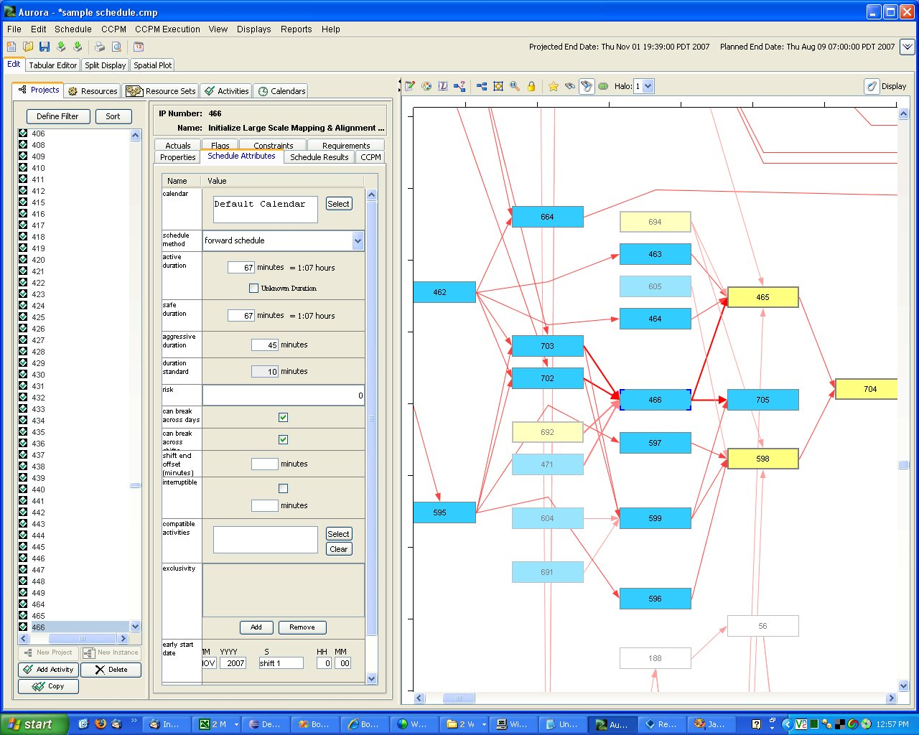

Slide 28
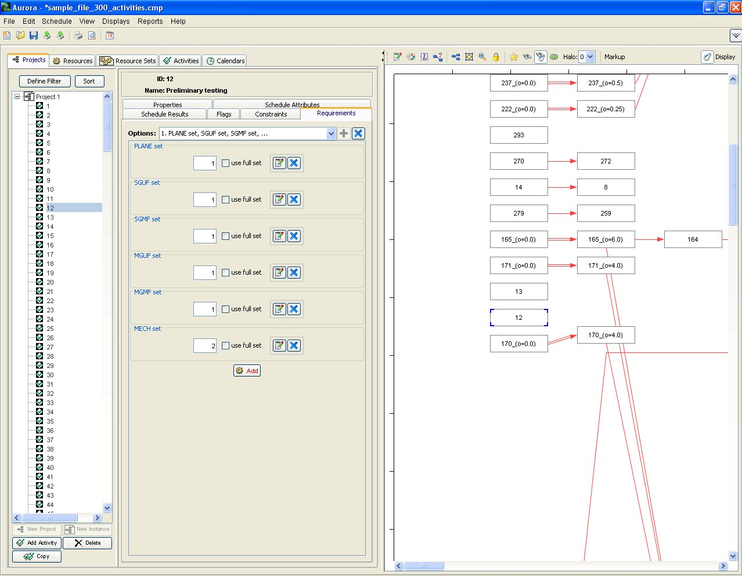

Slide 29
Video:
Aurora-CCPM Project Overview &
Constraints

Slide 30
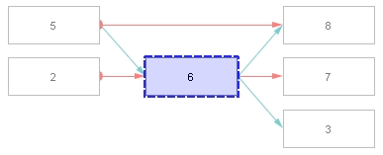
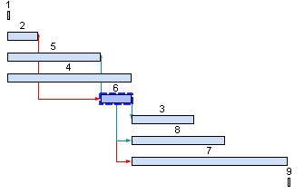
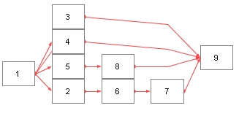
Resource Contention: Task 6
The Single Element Display in Aurora helps the user visualize the relationships between tasks:
Blue-grey lines denote a resource-constrained work flow
Red lines denote temporally-constrained work flow
Referring to the three diagrams to the right:
Task 6 can start any time after Task 2 is completed (red line in Single Element Display), but must wait for Task 5 to release resources (blue-grey line).
Tasks 3 and 8 must wait for 6 to release resources before they can start, as shown in the Gantt Chart View
Task 7 starts after Task 6 completes (red line in Single Element Display)
Single Element Display
Gantt Chart View
Overall schedule flow
Notes:
Each color represents a different skill category. Initially, two different critical paths. Resource leveling of traditional plan would create float in each of the two critical paths. What should be now identified as the Critical Path?

Slide 31
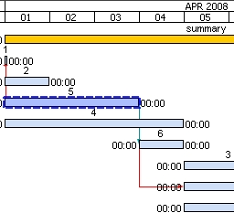
Resource Contention: Visual
Viewing resource contentions in Aurora
In this sample schedule, each task has a resource requirement attached as follows
Task # | Resources Needed
2 | 1
3 | 2
4 | 2
5 | 2
Resource-constrained
relationship
Note that there is a total amount of only 5 resources. Tasks 2, 4, and 5 are started at the same time (5 resources used). Task 2 completes, but there are not enough resources left to start Task 6, so Task 6 must wait until Task 5 is complete.
Aurora shows you this resource-constrained relationship with a blue-grey line between the two Tasks.
Notes:
Each color represents a different skill category. Initially, two different critical paths. Resource leveling of traditional plan would create float in each of the two critical paths. What should be now identified as the Critical Path?

Slide 32
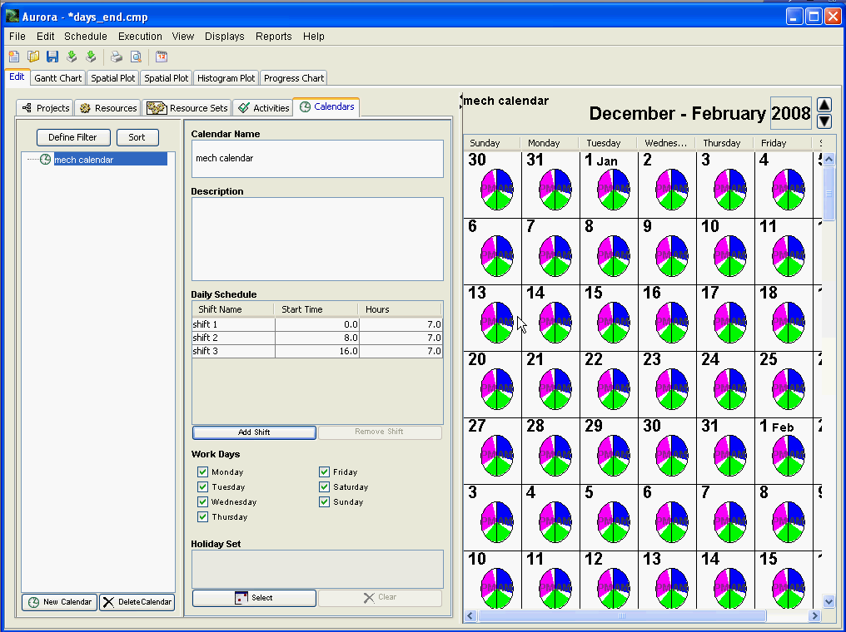
Calendars

Slide 33
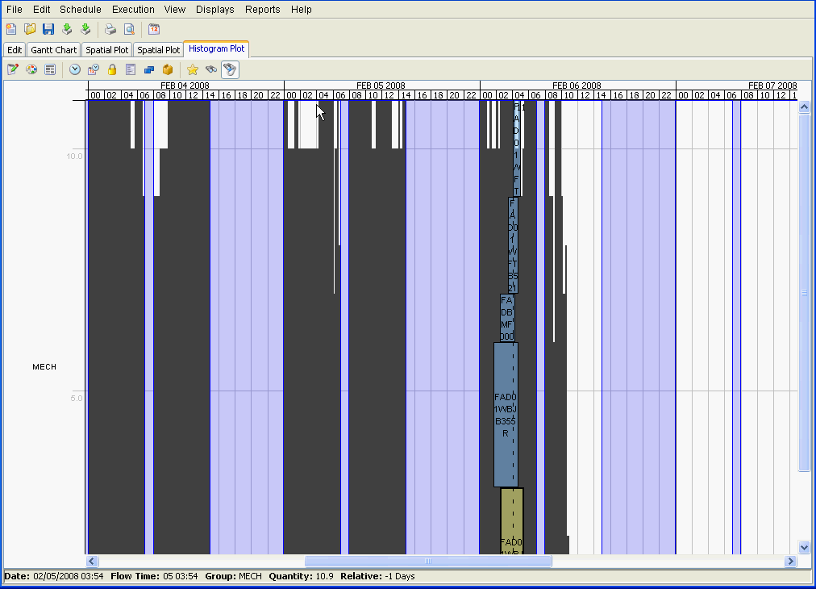
Histogram

Slide 34
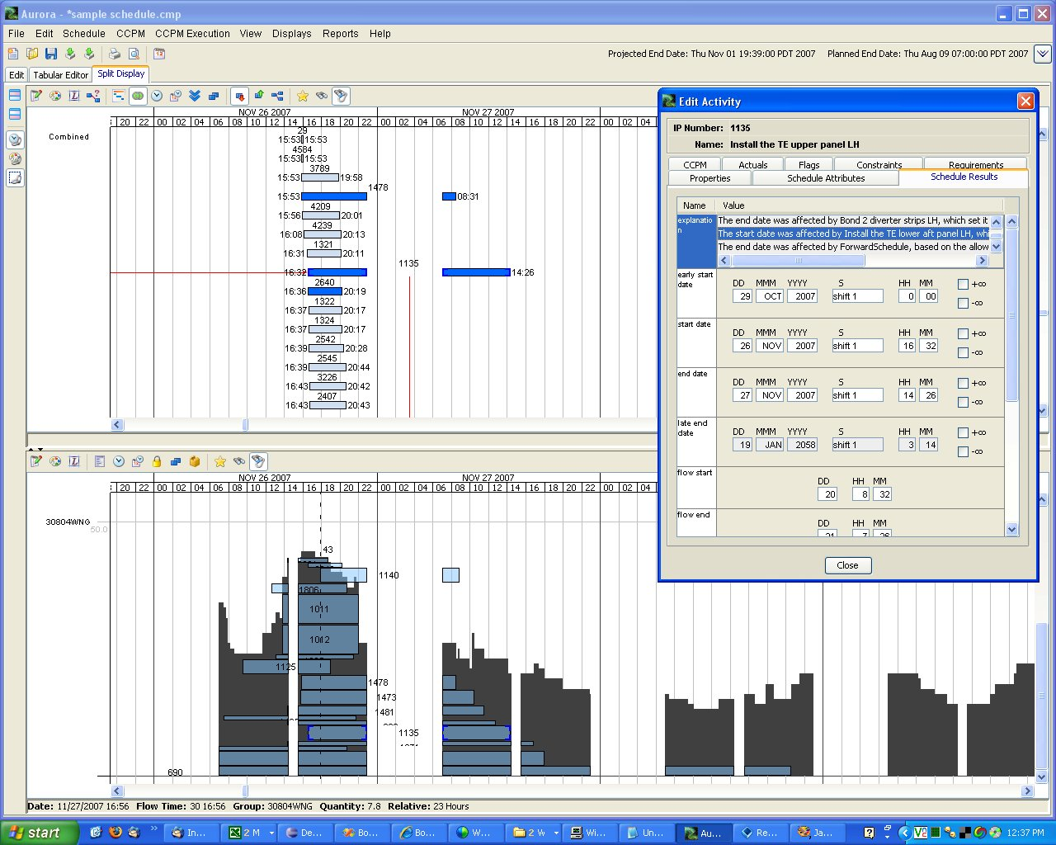

Slide 35
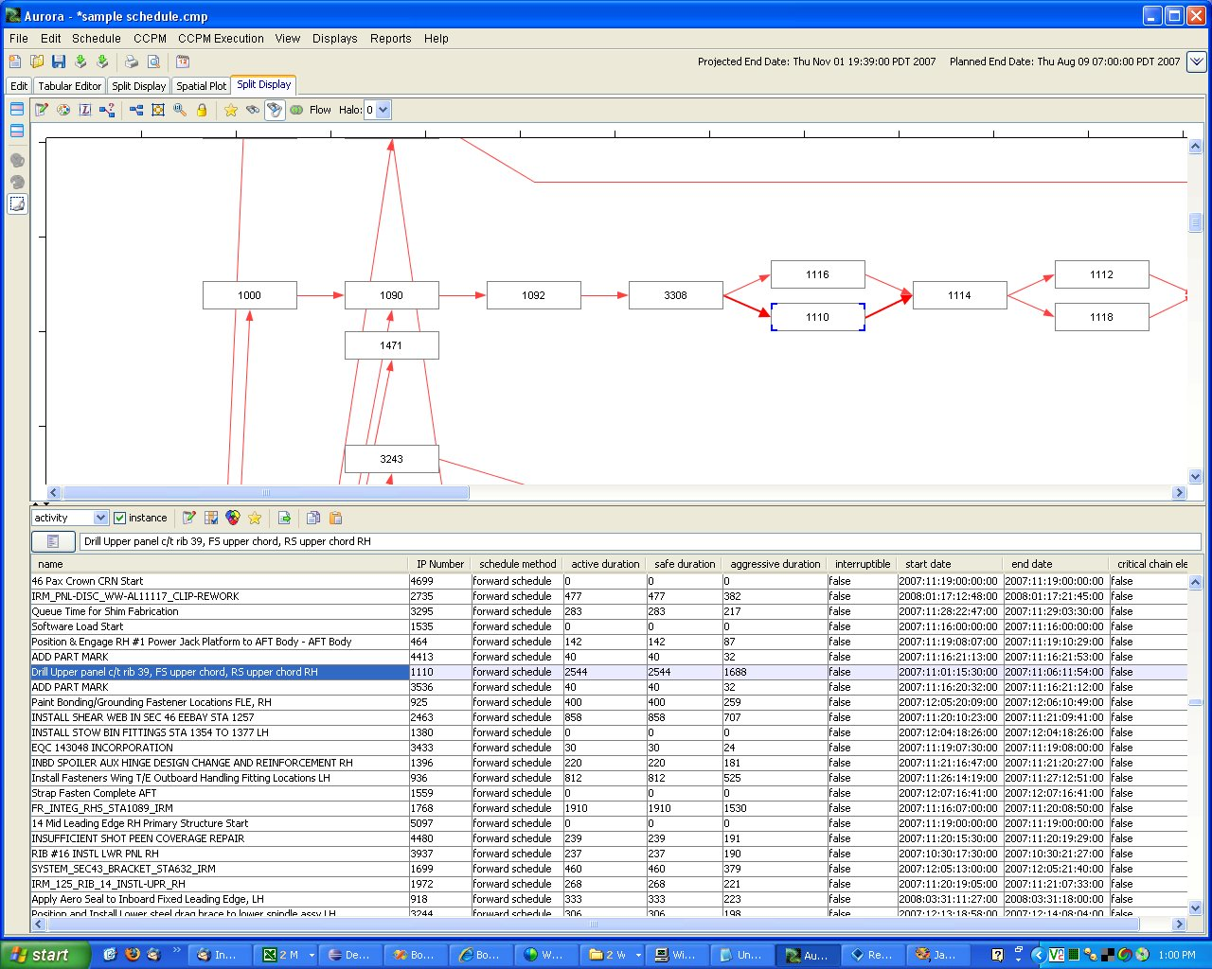

Slide 36
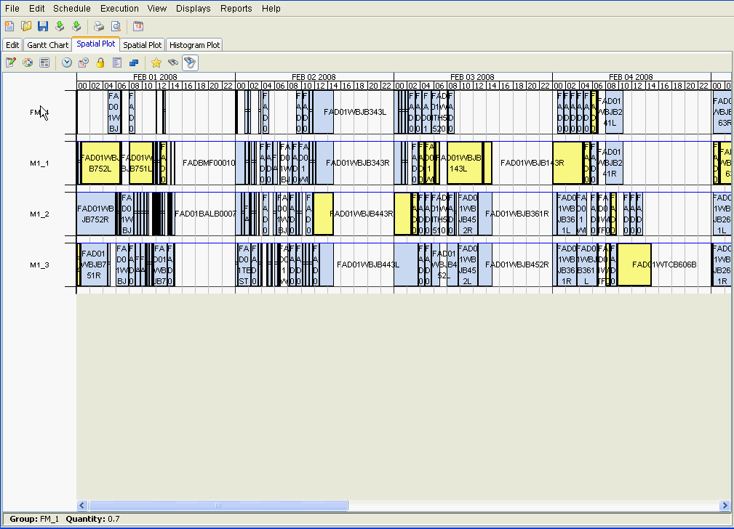
Spatial Plot
Notes:
Spatial resource plots
show how the resources in your model are utilized over time. The spatial plot display is most useful for visualizing the utilization of unitary resources, i.e. resources that are either in use or not in use (like a milling machine) as opposed to resources that can be used partially (like a group of workers).

Slide 37
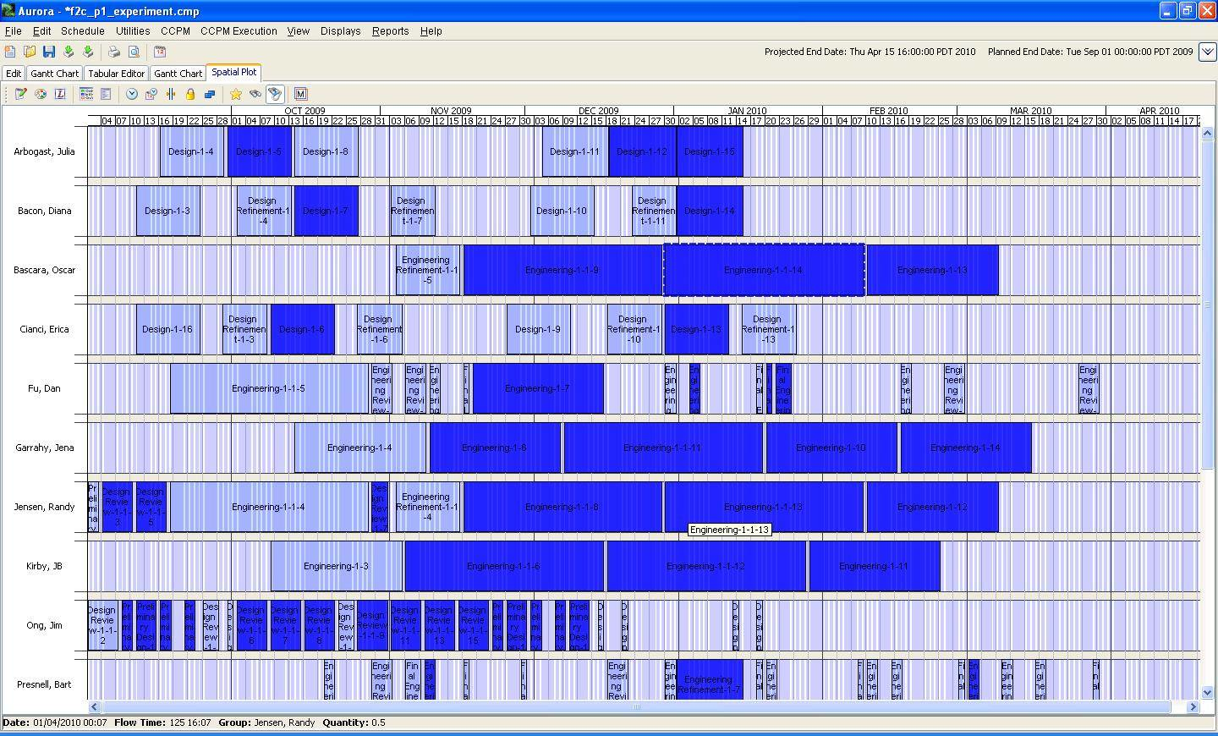
Personnel View Activities delayed by resource contention in blue

Slide 38
Schedule Rationale
Aurora includes the rationale for each task on why it was scheduled where it was scheduled, so it is easy to determine what changes could be made for a task to occur earlier.

Slide 39
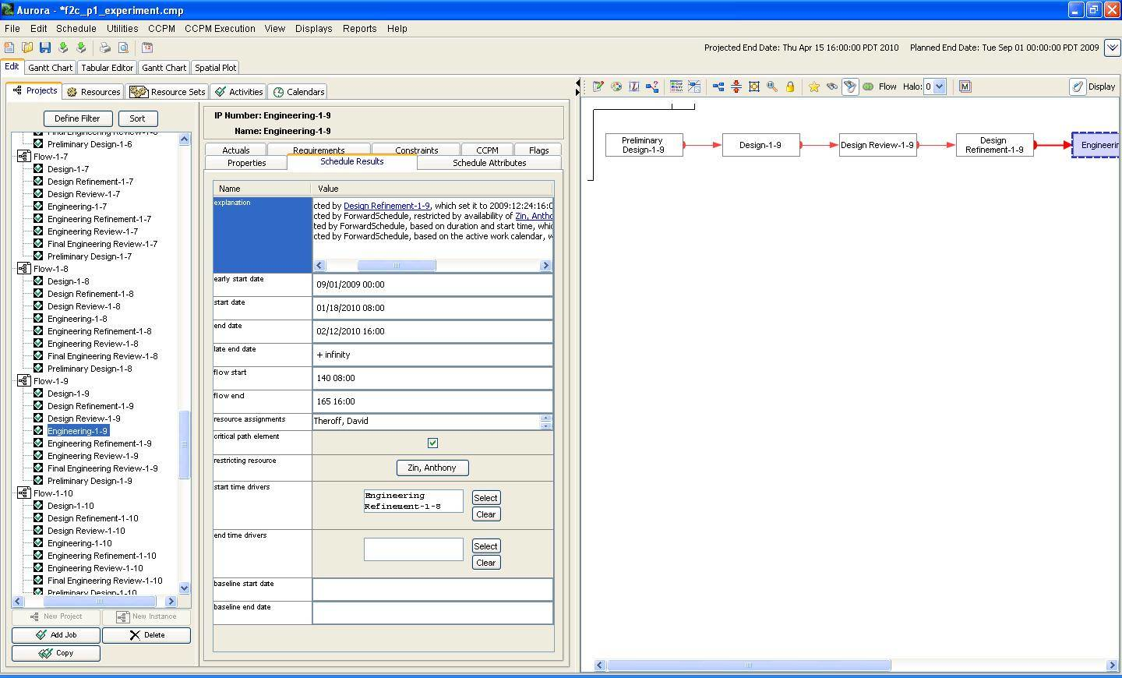
Edit Tab: Schedule Results

Slide 40
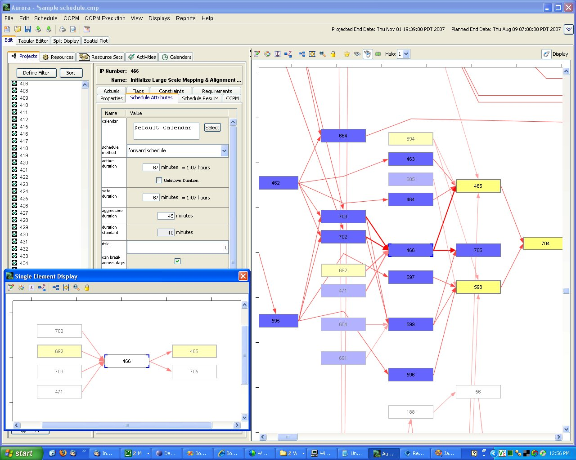

Slide 41
Video
Spatial Plot,
Single Element Display &
Explanation Facility

Slide 42
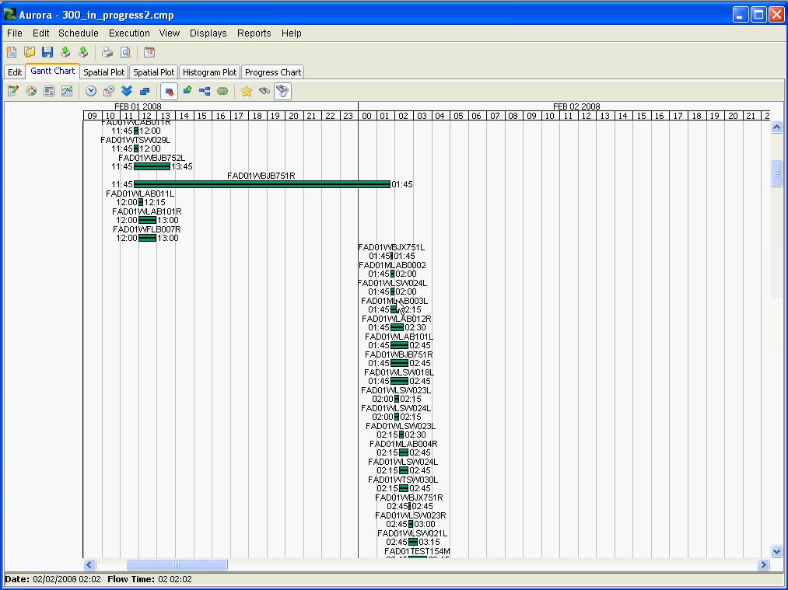
Gantt Chart in Execution

Slide 43
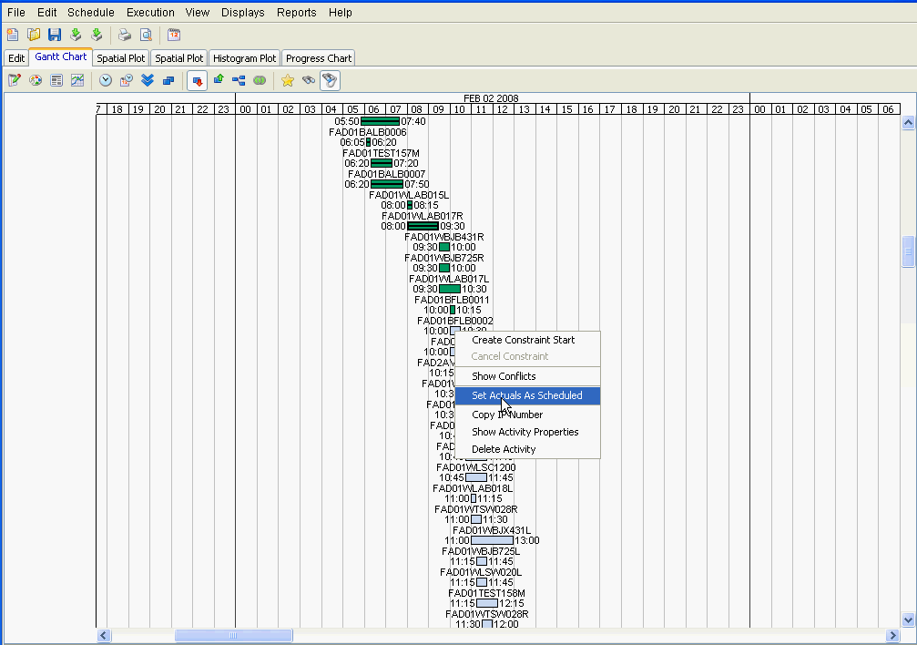
Gantt Chart with right-click menu

Slide 44
Video
Execution Mode
Fever Chart
Task Priority List

Slide 45
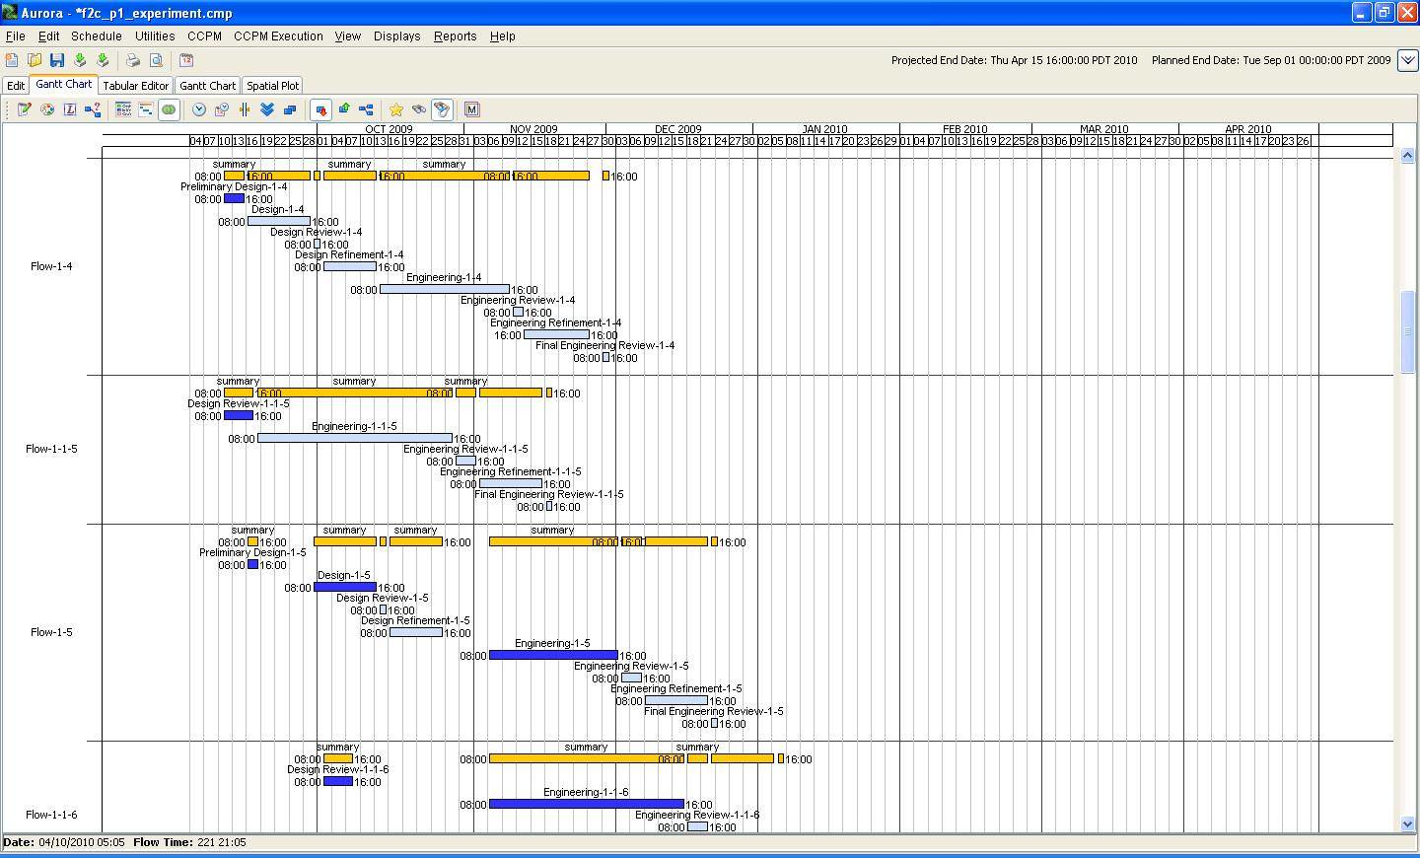
Gantt Chart: Multiple Projects Activities delayed by resource contention in blue

Slide 46
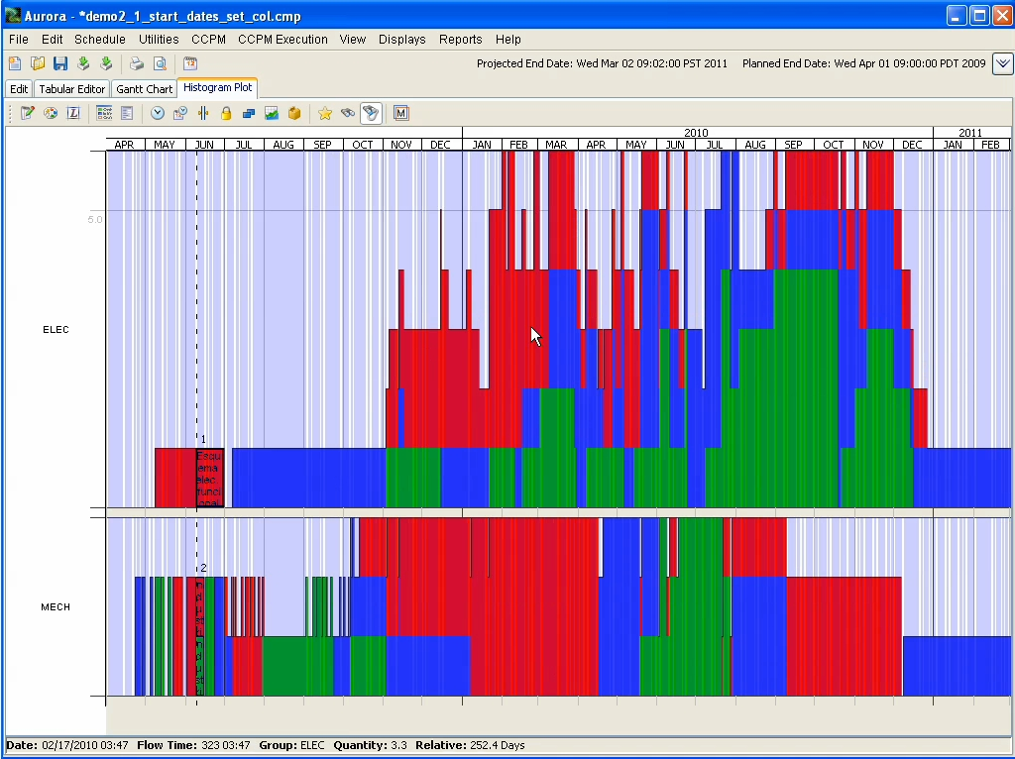

Slide 47

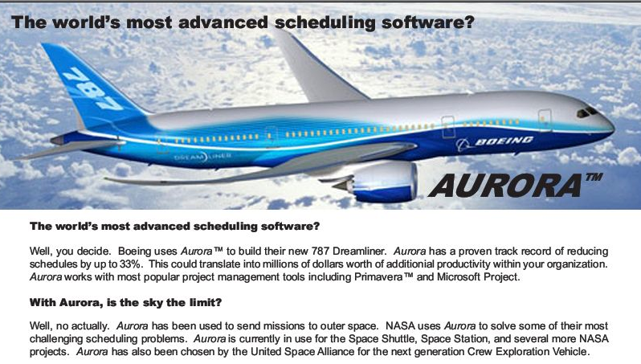




GRACIAS POR SU ATENCIÓN
Rob Richards, Ph.D.
Project Manager
Stottler Henke Associates, Inc.
Richards@Stottlerhenke.com
SYSTEM®
Value&Innovation

